Slide 1
Thermal Scan of DTG Landfill (West hill)
Performed by the Volatus Group for Friends of rocky top on location in Yakima, Wa
23Sep2022

Slide 2
Equipment used
UAS Type
DJI Matrice 600 (FAARN: FA3PTCAFHW)
Payload to do scan
FLIR Duo Pro R (SN: 372336)
Software to process
FLIR Thermal Studio

Slide 3
Objective of scan
To show thermal anomalies on the surface of the West Hill of DTG Landfill area.
In the past the surface has been recorded at 149°F at the surface (During winter months) of the west hill highlighted in red in the previous slide
Autodetect and image capture will be set to 135° F

Slide 4
Area Scanned
AO
Area Scanned

Slide 5
Reported values
During our initial scan of the west hill on 23Sep2022, the Volatus Group did an LOA (Local Area Orientation) of the area and conducted 2 scans between 11am-2pm. Highest surface temperature observed was 113° F
The following slides are compiled data taken from scan of all temps above 135° F

Slide 6
Area Scanned
AO
Hot Spot
Area Scanned

Slide 7
Flight 3
10/6/2022
Measurements
Max: 72.3°C (162.14°F)
Min: 27.2°C (80.96°F)
AREA OF INTREST

Slide 8
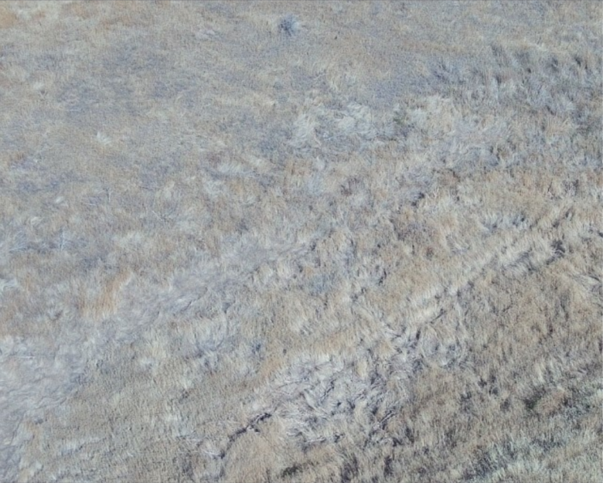
Flight 3
10/6/2022
Measurements
Max: 72.3°C (162.14°F)
Min: 27.2°C (80.96°F)

Slide 9
Flight 3
10/6/2022
Measurements
Max: 72.9°C (163.22°F)
Min: 32.3°C (90.14°F)
AREA OF INTREST

Slide 10
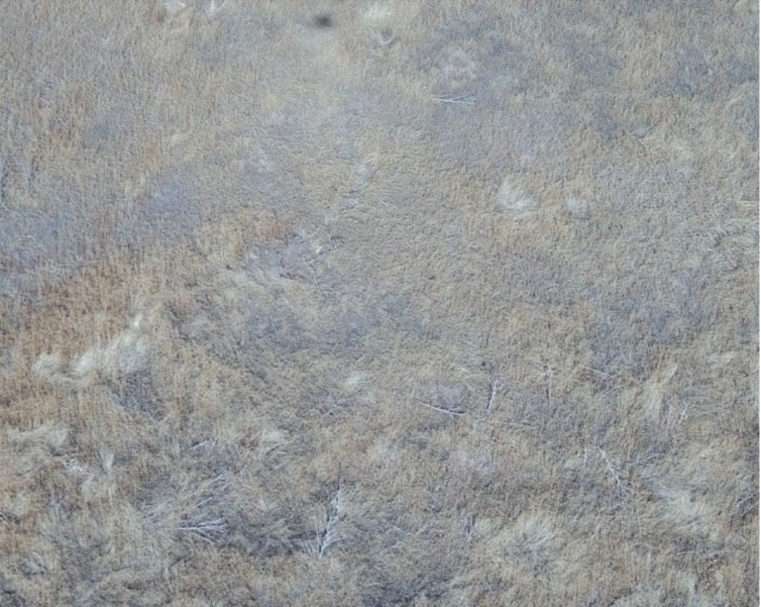
Flight 3
10/6/2022
Measurements
Max: 72.9°C (163.22°F)
Min: 32.3°C (90.14°F)

Slide 11
Flight 3
10/6/2022
Measurements
Max: 71.8°C (161.24°F)
Min: 31.7°C (89.06°F)
AREA OF INTREST

Slide 12
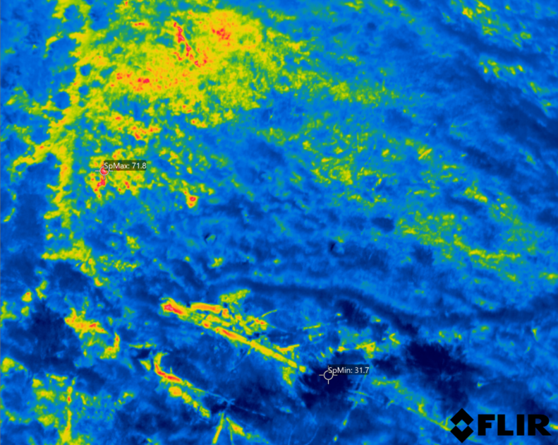
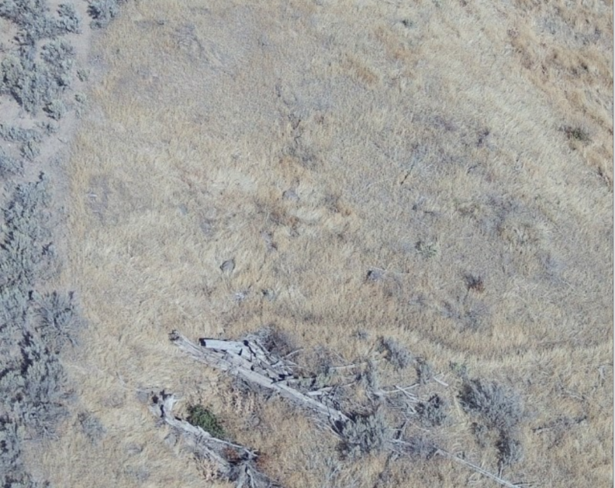
Flight 3
10/6/2022
Measurements
Max: 71.8°C (161.24°F)
Min: 31.7°C (89.06°F)

